Slide 1

Meta-analysis of prognostic factor studies
Thomas Debray, PhD

Slide 2

Prognostic factors

Slide 3
What are prognostic factors?
Any information that, among people with a given health condition, is associated with a subsequent health outcome
Example
Information:
tumour grade
Health condition:
patients diagnosed with cancer
Health outcome(s):
subsequent disease
recurrence of death

Slide 4
Common examples
Routinely collected patient characteristics
Sex
Age
body mass index
smoking status
blood pressure
co-morbidities
symptoms

Slide 5

Common examples
Biomarkers
Blood
Urine
Imaging
Electrophysiological
physiological variables

Slide 6
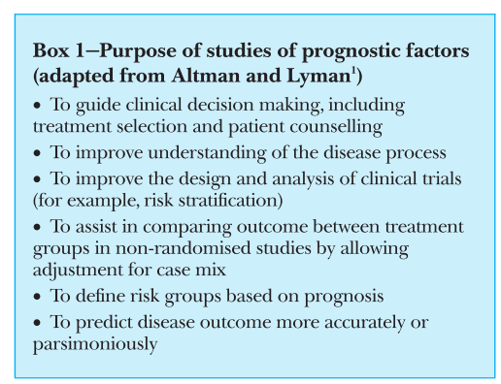
Use of prognostic factors
Aiding treatment decisions
Improving individual risk prediction
Providing novel targets for new treatment
Enhancing the design and analysis of randomised trials
Ref: Altman. Systematic reviews of evaluations of prognostic variables. BMJ 2001

Slide 7
Need for evidence synthesis
It is important to identify genuine prognostic factors.
However:
There is often conflicting evidence about the prognostic value of certain variables
The quality of many prognostic studies is poor
This motivates the need for systematic reviews and meta-analyses that summarise the (adjusted) prognostic effect of each factor of interest.

Slide 8
Data extraction

Slide 9
Data extraction
Key elements to extract for each factor of interest
Estimates of the (adjusted) prognostic effect
risk ratio or odds ratio (for binary outcomes)
hazard ratio (for time-to-event outcome)
mean difference (for continuous outcomes such as pain or depression score)
Corresponding standard errors or confidence intervals

Slide 10
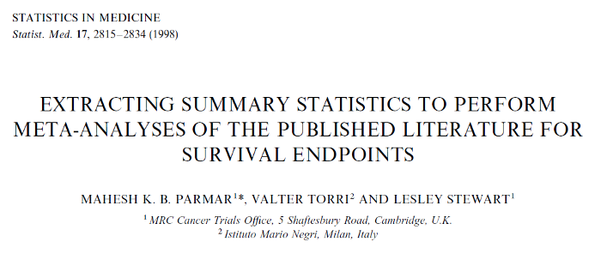
Data extraction
When not reported, unadjusted hazard ratios (and their variances) can be estimated:
using the number of outcomes (events) and an available p-value (e.g. from a log-rank test or Cox regression)

Slide 11
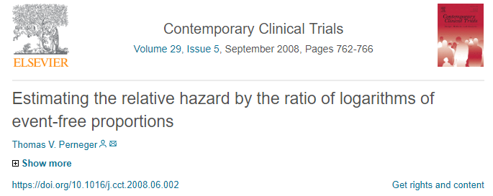
Data extraction
When not reported, unadjusted hazard ratios (and their variances) can be estimated:
from survival proportions

Slide 12
An example
A systematic review was performed
to evaluate the quality of prognostic research evidence
for the association of C-reactive protein (CRP)
with fatal and nonfatal events
among patients with stable coronary disease
Ref: 10.1371/journal.pmed.1000286

Slide 13
An example
Data extraction
“We extracted the reported relative risk, odds ratio or hazard ratio, and 95% CIs from each study.”
“We extracted the relative risks with the largest number of adjustment variables”
“We converted the reported relative risk estimates onto a standard scale of effect, comparing the highest third with the lowest third of the CRP distribution”
Ref: 10.1371/journal.pmed.1000286

Slide 14
Meta-Analysis

Slide 15
Meta-Analysis
Summarize multiple estimates of a certain factor-outcome association (e.g. log hazard ratios) 2 options:
Fixed effect meta-analysis
Random effects meta-analysis

Slide 16
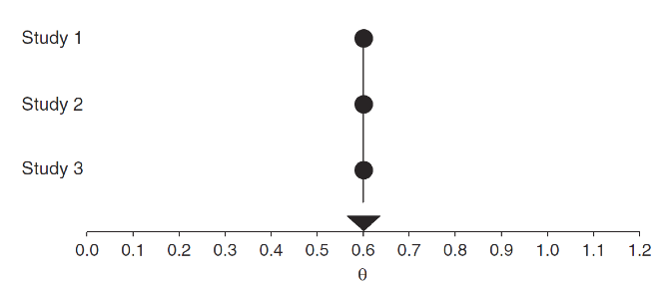
Fixed effect meta-analysis
It is assumed that all studies share the same factor-outcome association

Slide 17
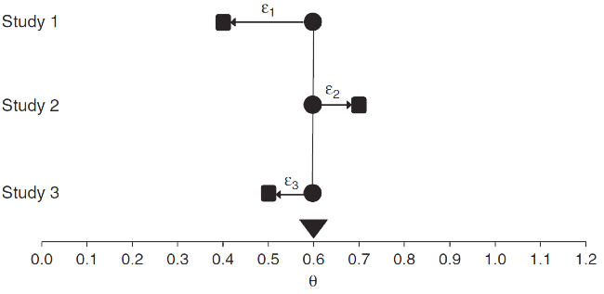
Fixed effect meta-analysis
It is assumed that all studies share the same factor-outcome association. The only source of variation is estimation error ($ε$) due to limited sample size.

Slide 18
Fixed effect meta-analysis
The pooled estimate is an average of all factor-outcome associations, weighted by their precision:
${\hat{θ}}_{k}∼$ N $(D_{F},$ $V\left(\hat{δ_{k}}\right))$
where
${\hat{θ}}_{k}$ represents the estimated factor-outcome association (e.g. log hazard ratio) of study k,
$V\left(\hat{δ_{k}}\right)$ is the error variance
$D_{F}$ is the fixed effect meta-analysis summary (e.g. pooled log hazard ratio)

Slide 19

Arguments against fixed effect MA
It is often unrealistic to assume that all studies estimate the same prognostic effect

Slide 20
Random effects meta-analysis
Unexplained heterogeneity is likely to exist due to:
Publication bias
Variation in study design & quality
Variation in inclusion criteria
Differences in treatments received during follow-up
Different types of prognostic effect measures (e.g. odds ratio and hazard ratios)
Different sets of adjustment factors
…
A random effects meta-analysis approach is essential to allow for unexplained heterogeneity across studies

Slide 21
Random effects meta-analysis
Heterogeneity may, for instance, appear when reviewing a continuous prognostic factor, as individual studies…
may consider non-linear trends
may consider a linear trend
may examine a trend across multiple categories of prognostic factor values.
may apply a cut-point (threshold) to dichotomise the continuous factor into two groups. The choice of cut-point often varies across studies

Slide 22
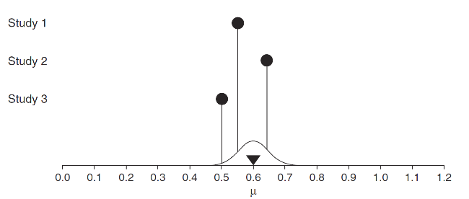
Random effects meta-analysis
Each study has a distinct prognostic effect, but there is a distribution of true effects. We are interested in estimating the mean (and variance) of this distribution

Slide 23
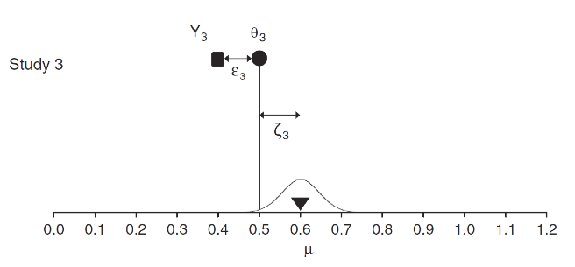
Random effects meta-analysis
The meta-analysis now accounts for 2 sources of variation:
Estimation error within studies ($ε$)
True variation in effect sizes between studies ($ζ$)

Slide 24
Random effects meta-analysis
We now have:
$${\hat{θ}}_{k}∼N\left(D_{F},V\left(\hat{δ_{k}}\right)\right)$$
$$\hat{δ_{k}}∼N\left(D_{R},τ^{2}\right)$$
With
$V\left(θ_{k}\right)$ the within-study error variance
$τ^{2}$ the between-study variance
$D_{R}$ is the random effect meta-analysis summary (e.g. pooled log hazard ratio)

Slide 26
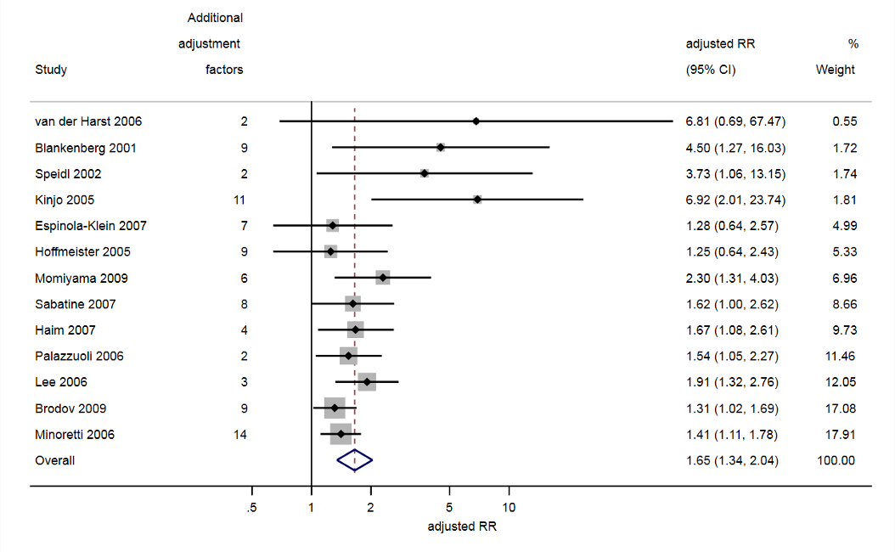
CRP example
Forest plot showing the study-specific estimates and meta-analysis summary result of the adjusted prognostic effect (risk ratio) of CRP. All studies were minimally adjusted for age, gender, smoking, diabetes, obesity, and lipids.

Slide 27
CRP example
The summary meta-analysis result was a risk ratio of 1.65 (95% CI: 1.34 to 2.04)
which gives the average prognostic effect of CRP (for those in the top versus bottom third of CRP distribution)
which suggests larger CRP values are associated with higher risk.
Ref: 10.1371/journal.pmed.1000286

Slide 28
Use of appropriate meta-analysis methods
When calculating confidence intervals
Adjust the standard error of the summary estimate using the method proposed by Hartung-Knapp-Sidik-Jonkman
Use a Student T distribution (instead of a Normal distribution)
Ref: IntHout et al. The Hartung-Knapp Sidik-Jonkman method for random effects meta-analysis is striaightforward and considerably outperforms the standard DerSimonian-Laird method. BMC Med Res Meth 2014

Slide 29
CRP example
The summary meta-analysis result was a risk ratio of
Without Hartung-Knapp correction
1.65 (95% CI: 1.39 to 1.96)
With Hartung-Knapp correction
1.65 (95% CI: 1.34 to 2.04)

Slide 30
Advanced meta-analysis methods
Dose-response models
to summarize the effect size as a function of exposure level
Multivariate meta-analysis methods, to jointly handle
multiple cut-points
multiple methods of measurement
different adjustment factors in prognostic factor studies

Slide 31
Investigating heterogeneity

Slide 32
Recommendations
If heterogeneity is present
The random-effects estimate should be interpreted differently from the fixed effect estimate
Focusing on the mean is insufficient, and the effect of heterogeneity should be quantified (e.g. prediction intervals)
Explore possible causes of heterogeneity

Slide 33
Prediction interval
We can derive an approximate 95% prediction interval, which provides a range for the true prognostic effect in a new study population:
$\hat{D_{R}}±$ $t_{K−2}$ $\sqrt{{\hat{τ}}^{2}+var\left(\hat{D_{R}}\right)}$
$t_{K−2}$ is the $100\left(1−α⁄2\right)$ percentile of the t distribution with K–2 degrees of freedom, where K is the number of studies in the meta-analysis and is usually chosen as 0.05, to give a 5% significance level and thus 95% prediction interval.
Note that the prediction interval can be calculated more accurately within a Bayesian framework (as it allows for estimation error of ${\hat{τ}}^{2}$)

Slide 34
CRP Example

Slide 35
Meta-regression
Adjust the meta-analysis for study-level variables
Study characteristics
Study design
Follow-up time
Predictor- and outcome definitions
Population characteristics
Mean of individual covariates
SD of individual covariates
Treatment standards
Such that the summary estimate becomes defined by one (or more) study-level covariates.

Slide 36
Meta-regression
Limitations
There will often be few studies per subgroup and low power to detect genuine causes of heterogeneity
Danger of study-level confounding, such that it is difficult to disentangle the associations for one covariate from another (ecological bias)
For example, studies with a low risk of bias may also have a different length of follow-up, or a particular cut-point level, compared with studies at higher risk of bias.

